Slide 1
Communicable Diseases
In Compliance With AAA Requirements
Christa Finney, MS, ATC, LAT
Arkansas Athletic Trainers’ Association

Slide 2
What do we mean by Communicable Diseases?
Any illness spread person-to-person through direct or indirect contact with a colonized or infected person.
  Direct contact – skin to skin
  Indirect contact – touching a surface a colonized or infected person previously touched.
  Colonized – carries disease but does not exhibit signs or symptoms
  Infected – Shows signs or symptoms of dz

Slide 3
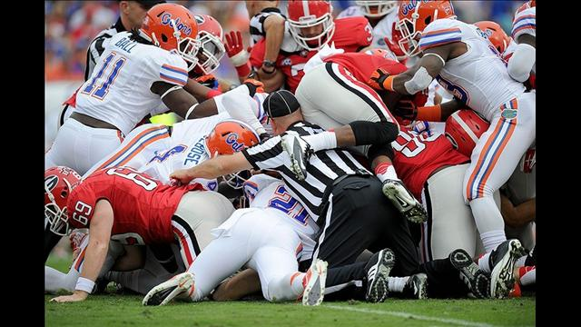
What do we mean…
Can happen anywhere large groups congregate.
Athletes are especially susceptible!
Caused by microorganisms
  Fungi
  Virus
  Bacteria

Slide 4
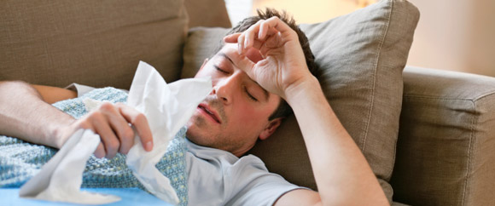
Common Illnesses
Upper respiratory
  Bronchitis
  Pneumonia
  Flu
  Usually viral
    Antibiotics will not help!
    Needs to run its course
    Treat symptoms

Slide 5
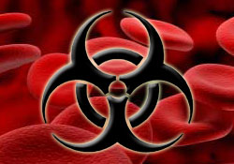
Common Illnesses
Bloodborne Pathogens
  HIV, AIDS, Hepatitis B, Hepatitis C
    No vaccine for Hep C
  Use Universal Precautions
  Contaminated surfaces and uniforms must be cleaned before play resumes
  Good rule of thumb: If it’s damp and it’s not yours, don’t touch it!

Slide 6

Common Illnesses
Meningitis
  Inflammation of membranes surrounding brain and spinal cord
  Viral or bacterial
    Bacterial more easily spread through saliva & throat secretions
    Do NOT share bottles, utensils, etc.
  Rapid onset fever, stiffness (neck), headache, light sensitivity, possible rash

Slide 7
Common Illnesses
Mononucleosis
  Caused by the Epstein-Barr Virus
  Signs & Symptoms
    Fever
    Sore throat
    Swollen lymph nodes
    Enlarged spleen
      Excess pressure or direct contact can rupture an enlarged spleen. THIS CAN BE FATAL!!!!!
  NO ACTIVITY FOR 3-4 WEEKS!!
      Includes running, lifting weights, contact, carrying equipment, etc.

Slide 8
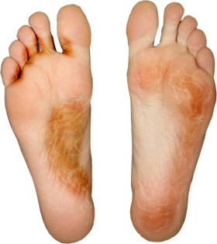
Skin Infections – Fungal
Athlete’s Foot
  Cracked, flaky skin between toes & on sides of feet
  Thrives in warm, moist environments
  Treated with topical fungicide
  Prevention
    Change socks during long practices & after practice
    Wear shower shoes in common shower areas

Slide 9
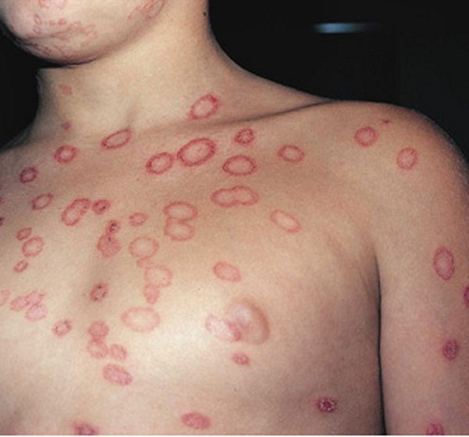
Skin Infections – Fungal
Ringworm
  NOT a worm, but a ring-shaped lesion
  Raised, itchy, scaly patches that are darker on outside and lighter in middle
  Skin-to-skin contact, indirect contact, pets
  Treated with topical fungicide
  Prevention
    No scratching
    Change bedding daily
    Keep pets clean
  MUST BE CLEARED BY MD

Slide 10
Skin Infections – Viral
Herpes
  Caused by Herpes Simplex I Virus
  Clusters of blisters, fever, swollen lymph nodes, burning and tingling of skin
  Spread through saliva & throat secretions, skin-to-skin contact, & from colonized person
Sub-class: Herpes Gladiatorum
  Most common in wrestlers
  NO practice or competition until the area is dry and scabbed over
  MUST BE CLEARED BY AN MD!!!!!

Slide 11
Skin Infections – Viral
Molluscum Contagiosum
  Most common in wrestlers
  Itchy, pearl-like nodules
  Athlete MUST be isolated from the team
  MUST BE CLEARED BY AN MD
All viral skin infections invade healthy body cells and use their energy stores to multiply.

Slide 12
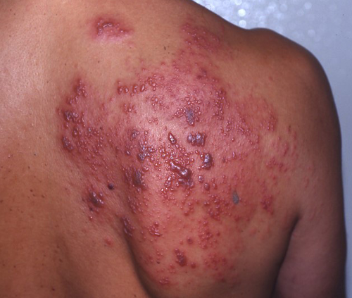
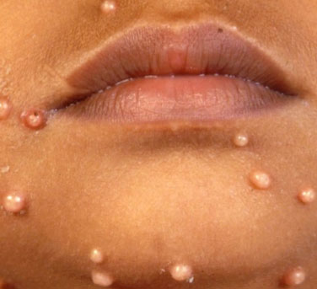
Skin Infections – Viral
Herpes Gladiatorum
Molluscum Contagiosum

Slide 13
Skin Infections – Bacterial
Streptococcal Impetigo
  Strep Group A
  Incubates 1-3 days post-exposure
  Red, itchy sores that break open & ooze bacteria-containing fluid
  Treated thru oral & topical antibiotics
  Wash area several times a day w/antibacterial soap
Practices and competitions
  NOT sufficient to just cover the infection
  NO PARTICIPATION until on meds for 72 hr
  MUST be free of drainage
  NO NEW lesions can appear before resuming participation
  MUST BE CLEARED BY AN MD!!!!!

Slide 14
Skin Infections – Bacterial
MRSA
  Does not respond to methicillin antibiotic
  Everyone carries staph on their skin
  Hard to dx at first
    May look like impetigo, pimple, or insect bite
  HIGHLY CONTAGIOUS!!
    Entire football teams have been shut down in Arkansas!
Can get into your blood and organs causing weakness, paralysis, EVEN DEATH!
Symptoms
  Skin – boils, abcesses
  Corresponding organ
    Heart – murmur, infections, failure
    Lungs – pneumonia, bronchitis, SOB
Can deteriorate in a matter of hours!!
MUST be isolated & cleared by an MD!!

Slide 15
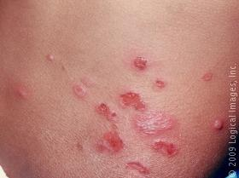
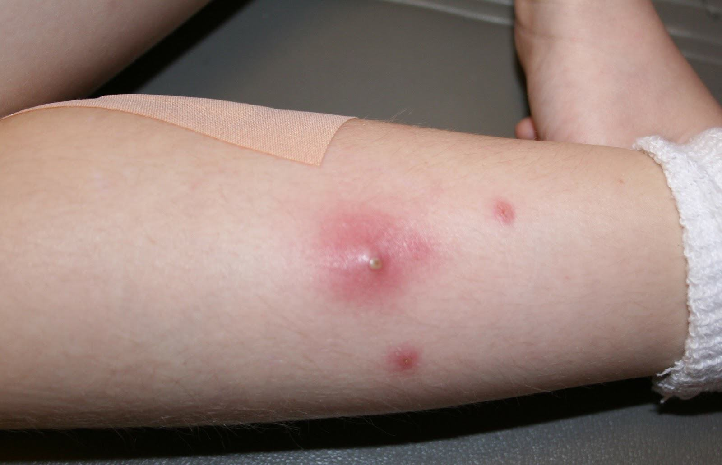
Skin Infections – Bacterial
Streptococcal Impetigo
MRSA

Slide 16
Prevention
Wash hands for at least 15 seconds using antibacterial soap
  Get in habit of washing hands before practice!
Sneeze/cough into bend of elbow
DO NOT SHARE personal items such as towels, razors, bar soap, deodorant, combs, etc.
Take home & wash practice clothes each day!
Shower ASAP after each practice or game.
Shoes and socks should be kept dry.
Surfaces such as mats, treatment tables, weight benches and bars, turf, etc. must be kept clean & disinfected after use.
COVER cuts & abrasions!
DO NOT SHARE water bottles if possible. If it is necessary, keep bottles and coolers clean!

Slide 17
SUDDEN CARDIAC ARREST
CHRISTA FINNEY, MS, LAT, ATC
ARKANSAS ATHLETIC TRAINERS’ ASSOCIATION

Slide 18
WHAT IS SUDDEN CARDIAC ARREST (SCA)?
SCA IS THE SUDDEN, UNEXPECTED LOSS OF HEART FUNCTION, BREATHING, AND CONSCIOUSNESS.
RESULTS FROM ELECTRICAL DISTURBANCE IN THE HEART CAUSING IT TO BEAT VERY RAPIDLY (VENTRICULAR FIBRILLATION) FOLLOWED QUICKLY BY LACK OF A PULSE.
VICTIMS TYPICALLY LOSE CONSCIOUSNESS WITHIN A MATTER OF SECONDS.

Slide 19
WHAT IS SCA?
WITHOUT IMMEDIATE CPR TO HELP THE HEART CONTINUE TO TRANSPORT AND MAINTAIN THE SUPPLY OF OXYGENATED BLOOD TO VITAL ORGANS AND THE SHOCK OF AN AED TO RESTORE NORMAL HEART RHYTHM, VICTIMS USUALLY DIE.
WAITING FOR PARAMEDICS OR AMBULANCE TO ARRIVE IS OFTEN TOO LATE.

Slide 20
WHAT IS SCA?
SCA IS DIFFERENT THAN A HEART ATTACK, WHICH OCCURS WHEN BLOOD FLOW TO A PORTION OF THE HEART IS BLOCKED.
HOWEVER, A HEART ATTACK CAN SOMETIMES TRIGGER AN ELECTRICAL DISTURBANCE THAT LEADS TO SCA.
IT IS THE LEADING CAUSE OF DEATH IN YOUNG ATHLETES WHILE EXERCISING.

Slide 21
SIGNS AND SYMPTOMS OF SCA
OFTEN DRASTIC, IMMEDIATE, AND GIVE LITTLE WARNING.
CHEST PAIN AND BLACKOUTS, ESPECIALLY WITH EXERTION
FAINTING
PALPITATIONS OR FLUTTERING OF THE HEART
BECOMING EASILY FATIGUED
WEAKNESS
DIZZINESS
VOMITING
SHORTNESS OF BREATH
SUDDEN COLLAPSE
NO PULSE
NO BREATHING
LOSS OF CONSCIOUSNESS

Slide 22

WHAT TO DO IF YOU SUSPECT SCA
CLEAR THE SCENE
RULE OUT ANY HEAD, NECK, OR SPINE INJURY
BEGIN CPR AND RETRIEVE THE CLOSEST AED.
ACTIVATE EMS AND CONTINUE CPR/AED UNTIL EMS TAKES CONTROL OF THE SCENE.

